Slide 1
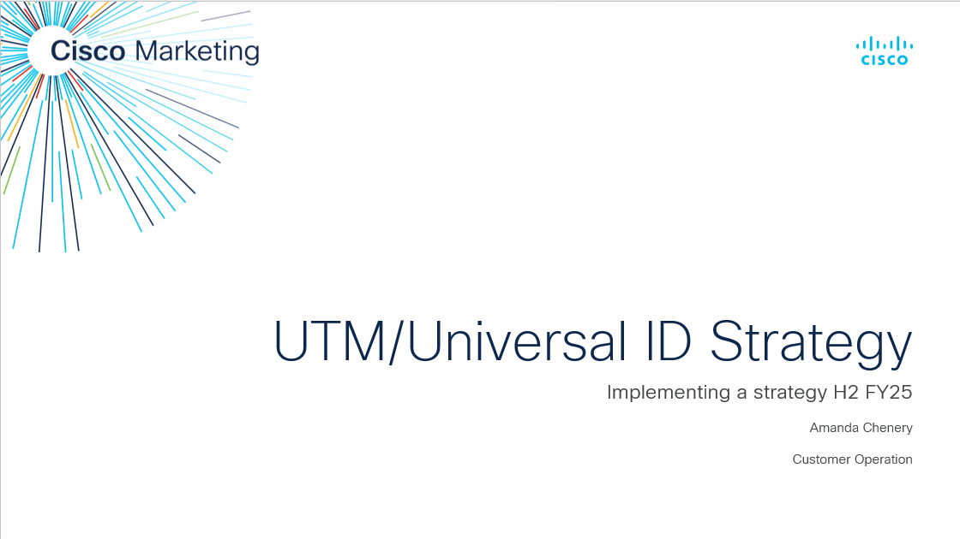
GOAL
Our Goal
Automate the creation of Universal IDs and UTM codes
Deliver standard marketing effectiveness reports from Adobe reporting
Align the new strategy in Ace reporting
Maintain one standard tool to create and manage IDs and UTM values
VISION
An automated solution within marketing to use data driven insights to understand the performance of our marketing initiatives
MISSION
Define a phased approach to implement a UTM Strategy for existing activations to align with the approach moving forward in the Adobe suite of tools

Slide 2
GOAL
Our Goal
MISSION
Automate the creation of Universal IDs and UTM codes
Deliver standard marketing effectiveness reports from Adobe reporting
Align the new strategy in Ace reporting
Maintain one standard tool to create and manage IDs and UTM values
VISION
Define a phased approach to implement a UTM Strategy for existing activations to align with the approach moving forward in the Adobe suite of tools
An automated solution within marketing to use data driven insights to understand the performance of our marketing initiatives

Slide 3
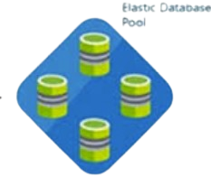









ID Management System - Current
Web Experience Management
(WEM) Author
Campaign Tagging & Tracking Tool
Chat & Phone
Oracle App Cloud
Events
Leads
Oracle

Slide 4
UTM Parameters
UTM_SOURCE
UTM_ID
UTM_MEDIUM
Purpose: : Identifies which platform or website sent the traffic to the marketing campaign
Benefit: By tracking the source (e.g., Google, Facebook, Newsletter), marketers can determine which channels are driving the most visitors and optimize future campaigns accordingly. It helps assess where to allocate marketing resources most effectively.
Cisco Alignment: Sub Vehicle/Vendor
UTM_CAMPAIGN
Activity ID
Purpose: Describes the medium or type of marketing used (e.g., email, social media, CPC - cost-per-click).
Benefit: It allows marketers to understand the performance of different marketing methods. For example, it can differentiate whether the traffic came from a paid ad, an organic post, or an email campaign. This helps in refining strategies based on medium effectiveness.
Cisco Alignment: Vehicle
UTM_ID
Purpose: : Captures a universal ID that holds pertinent data attributes that can be utilized for reporting
Benefit: By using a universal we can add data attributes specific to Cisco that will give us the ability to add other dimensions to tracking, as and when defined and will allow us to work with the existing lead creation structure in Salesforce
Cisco Alignment: Activity ID (CCID)
Purpose: Identifies the specific campaign or promotion associated with the traffic (e.g., winter_sale, launch_promotion).
Benefit: This parameter is key for tracking the performance of individual campaigns, enabling marketers to evaluate the success of each marketing initiative. By understanding which campaigns yield the best ROI, a marketing team can refine future promotional strategies.
Cisco Alignment: No Comparison
Notes:
In summary IDs can be captured in 3 main places
Appended to URL
HTML of Landing Pages
Static Transactions such as Manual Uploads, Global Event & Content Syndication Integrations
URLS
The Activity ID, Drive To ID and Event ID will only be written to local storage on the first interaction with Cisco.com for this visit
Any ID appended to internal pages or call to actions will be ignored and not written to Local Storage but will be written to Weblogs
Landing Page
The Offer ID will be taken from the HTML of the Landing Page of a Gated Offer
The Activity ID and EID will be taken from the HTML of the Landing Page – ONLY if the customer rejected cookies and we have no information in Page Logic
Automatically aligned – however, the mapping has not been updated in over a year and doesn’t align with the FY25 Campaigns

Slide 5
UTM Standards
Mandatory
Mandatory
UTM_MEDIUM
Purpose: Describes the medium or type of marketing used (e.g., email, social media, CPC - cost-per-click).
Benefit: It allows marketers to understand the performance of different marketing methods. For example, it can differentiate whether the traffic came from a paid ad, an organic post, or an email campaign. This helps in refining strategies based on medium effectiveness.
Cisco Alignment: Vehicle
UTM_ID
Purpose: Captures the Activity ID
Benefit: Track specific marketing initiatives generating customer activity that support Cisco’s Global Campaigns, Programs & Buyers Lens.. When the CTT Tool is decommissioned this value will revert to the Workfront ID
Cisco Alignment: CCID
UTM_SOURCE
Purpose: : Identifies which platform or website sent the traffic to the marketing campaign
Benefit: By tracking the source (e.g., Google, Facebook, Newsletter), marketers can determine which channels are driving the most visitors and optimize future campaigns accordingly. It helps assess where to allocate marketing resources most effectively.
Cisco Alignment: Sub Vehicle/Vendor
UTM_EID
Purpose: Captures the EID for Events
Benefit: Captures alignment to Events created in the Meeting Request Form and will be in alignment to that ID until we are able to move the data into Workfront – Only mandatory for Event Data
Cisco Alignment: EID
UTM_CAMPAIGN
Purpose: Identifies the specific campaign or promotion associated with the traffic - only free format value available
Benefit: This parameter is key for tracking the performance of individual campaigns, enabling marketers to evaluate the success of each marketing initiative. By understanding which campaigns yield the best ROI, a marketing team can refine future promotional strategies. The information in this field is for individual teams use only and is not a company strategic value
Cisco Alignment: No Comparison

Slide 6
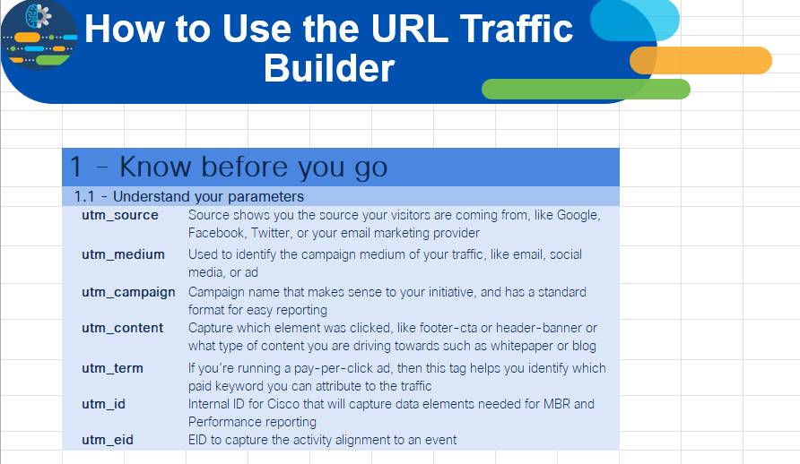
UTM Standards
Optional – Future Feature
UTM Traffic Builder
UTM_CONTENT
Purpose: Differentiates content within the same campaign (e.g., link A vs. link B or a banner ad vs. a text link).
Benefit: This helps marketers test different creative elements (such as images or messaging) in their campaign. It enables A/B testing, so teams can determine which content type is most effective in converting visitors, leading to better engagement and conversions.
Cisco Alignment: No Comparison
UTM_TERM
Purpose: Typically used to identify paid search keywords associated with the campaign.
Benefit: By tagging specific keywords, marketers can track which keywords are driving the most relevant traffic, helping improve keyword bidding strategies in paid search campaigns. This ensures more targeted ads and more efficient use of the marketing budget.
Cisco Alignment: No Comparison
UTM Traffic Builder Link
UTM_CREATIVE
Purpose: records the visual content of your ad campaign that first brought a specific user to your website and is found in user acquisition reports
Benefit: To get precise insights into which specific ad creatives, social posts, or email subjects drive traffic and conversions to your website
Cisco Alignment: No Comparison
Traffic Builder is only used for teams NOT working via Workfront

Slide 7

Email Campaign – Marketo
Mandatory
https://webinars.cisco.com/apjc/future-proof-your-workforce
Destination URL
utm_id= cc005042
utm_medium=email
Universal IDs Universal ID with data attributes aligned
utm_medium How the visitor is getting here
utm_source=marketo
cb_clb_fy25q3_apjc_futureproof-exec-panel
utm_source Where the visitor is coming from
<buying centre>-<program>-<fy#q#>-<region>-<details/placement
utm_campaign Why the visitor is getting here
Optional
utm_content=webinar
utm_term=
utm_content
What content are you driving to
utm_term what did the customer search or click on
https://webinars.cisco.com/apjc/future-proof-your-workforce?utm_id=cc005042&utm_eid=110392&utm_medium=email&utm_source=marketo&utm_campaign=cb_clb_fy25q3_apjc_futureproof-exec-panel&utm_content=webinar
utm_eid=110392
N.B I would hope to have EID as part of the utm_id but due to limitations of MRF we may have to have separate fields for MVP
Event ID What Event is driving this

Slide 8
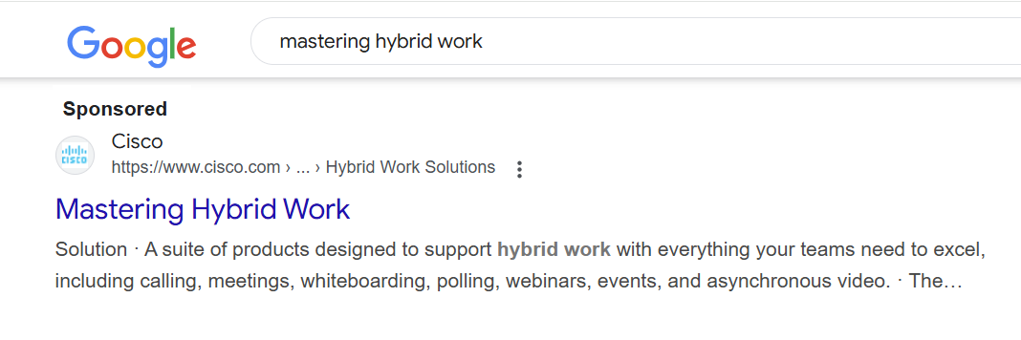
Paid Search Campaign –Marketo MVP
Mandatory
https://webinars.cisco.com/apjc/future-proof-your-workforce
Destination URL
utm_id= cc005042
utm_medium=cpc
Universal IDs Universal ID with data attributes aligned
utm_medium How the visitor is getting here
utm_source=google
cb_clb_fy25q3_apjc_futureproof-exec-panel
<buying centre>-<program>-<fy#q#>-<region>-<details/placement
utm_source Where the visitor is coming from
utm_campaign Why the visitor is getting here
https://webinars.cisco.com/apjc/future-proof-your-workforce?utm_id=cc005042&utm_eid=110392&utm_medium=cpc&utm_source=google&utm_campaign=cb_clb_fy25q3_apjc_futureproof-exec-panel&utm_content=webinar&utm_term=hybrid work
Optional
utm_content=webinar
utm_term=hybrid-work
utm_content
What content are you driving to
utm_term what did the customer search or click on
utm_eid=110392
N.B I would hope to have EID as part of the utm_id but due to limitations of MRF we may have to have separate fields for MVP
Event ID What Event is driving this

Slide 9
Email Campaign – Workfront Legacy
Mandatory
https://webinars.cisco.com/apjc/future-proof-your-workforce
Destination URL
ccid= cc005042&dtid=oemels00119
utm_medium=email
CTT IDS CTT IDs with data attributes aligned
utm_medium How the visitor is getting here
utm_source=marketo
cb_clb_fy25q3_apjc_futureproof-exec-panel
utm_source Where the visitor is coming from
<buying centre>-<program>-<fy#q#>-<region>-<details/placement
utm_campaign Why the visitor is getting here
https://webinars.cisco.com/apjc/future-proof-your-workforce?ccid=cc005042&dtid=oemls001119&eid=110392&utm_medium=email&utm_source=marketo&utm_campaign=cb_clb_fy25q3_apjc_futureproof-exec-panel
Optional
eid=110392
Event ID What Event is driving this

Slide 10
Paid Search Campaign – Workfront Legacy
Mandatory
https://webinars.cisco.com/apjc/future-proof-your-workforce
Destination URL
ccid=cc005042&dtid=psexsp00164
utm_medium=cpc
CTT IDS CTT IDs with data attributes aligned
utm_medium How the visitor is getting here
utm_source=google
cb_clb_fy25q3_apjc_futureproof-exec-panel
<buying centre>-<program>-<fy#q#>-<region>-<details/placement
https://webinars.cisco.com/apjc/future-proof-your-workforce?ccid=cc005042&dtid=psexsp001647&eid=110392&utm_medium=cpc&utm_source=google&utm_campaign=cb_clb_fy25q3_apjc_futureproof-exec-panel
utm_source Where the visitor is coming from
utm_campaign Why the visitor is getting here
Optional
eid=110392
Event ID What Event is driving this

Slide 11
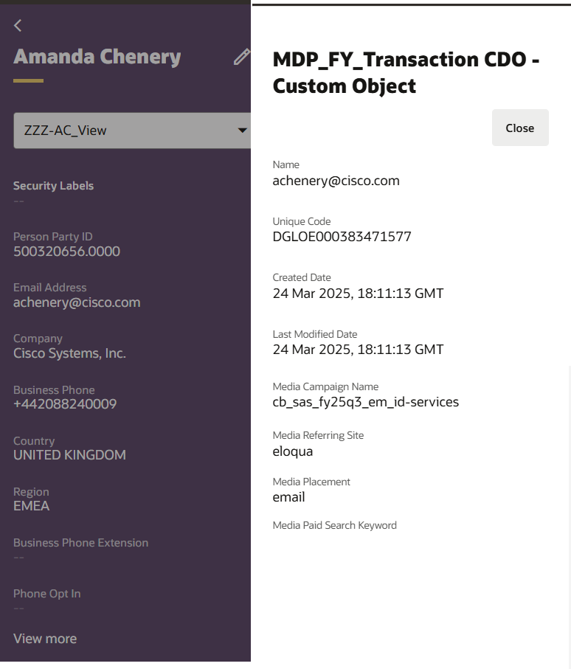
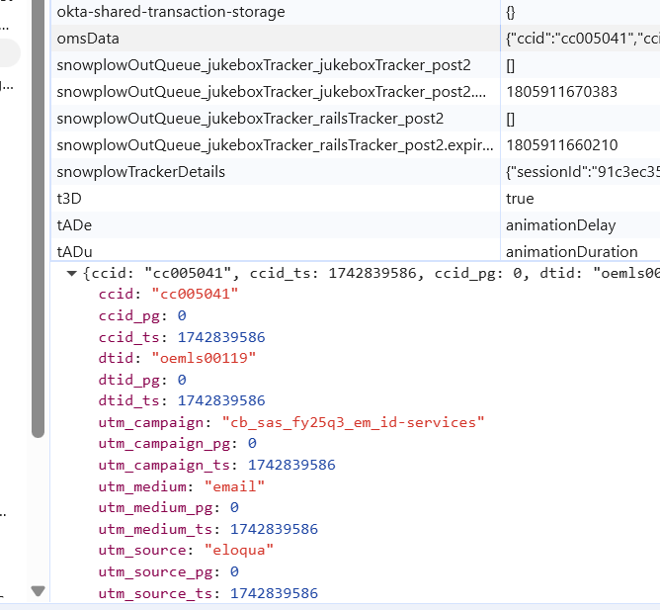
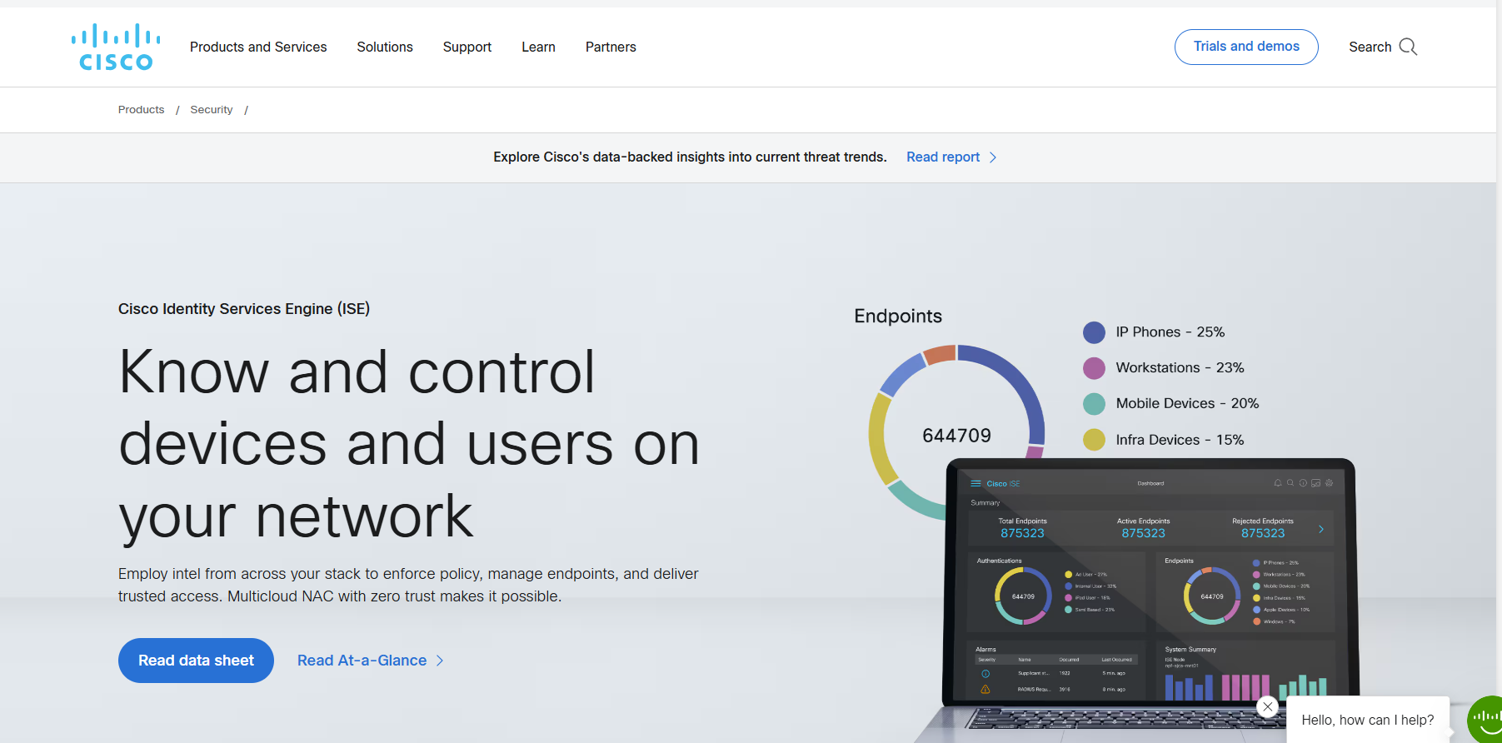
UTM – Eloqua Capture
https://www.cisco.com/site/us/en/products/security/identity-services-engine/index.html?ccid=cc005041&dtid=oemls00119&utm_id=cc005042&utm_eid=11089&utm_medium=email&utm_source=eloqua&utm_campaign=cb_sas_fy25q3_em_id-services
Data for UTM Values captured in Local Storage
UTM Values written to Eloqua Transaction CDO
UTM | Eloqua
utm_medium | Media Placement
utm_source | Media Referring Site
utm_campaign | Media Campaign Name

Slide 12
Phase 1 & 2 Timelines
Workfront Changes
Updates to Workflows and intake forms completed in Dev environment
Documentation
DART and Campaign Tagging and Tracking SharePoint documentation updated
March 2025
April 2025
May 2025
April 2025
April 2025
Agreement
Requirements document created, issues addressed and agreed solution
Communications & Training
Updates to SIIA, PODs and Global Field Marketing to address changes
Release
Removal of need for teams using Workfront to create their own Activity ID

Slide 13
Request goes into Approval Process
Approved
Marketing continues with DART Process
Marketing requests Activity ID
Yes
Activity ID created in CTT Tool
Amendments made as necessary
Marketing Initiates Dart Request
All Data Attributes Captured
DART PMM creates ID
DART PMM creates URL Parameters
DART Process Continues

